Slide 1
Assignments 5-7
Trees: Binary tree, Binary Search Tree, Heap, Priority Queue, Huffman Tree
Data Structures, Fall 2018
TA: Marija Stanojevic

Slide 2
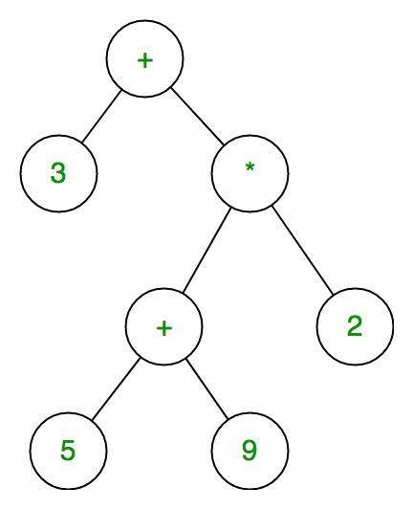
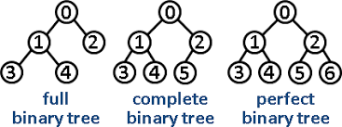
Introduction
Binary tree is set of nodes T, so that:
T is empty or
T consists of root node with two subtrees T_{L}, T_{R} which are binary trees
Types:
Expression Tree
Binary Search Tree
Huffman Tree
Special properties:
Full tree: each node has 0 or 2 children
Perfect tree: full tree of height n with 2^{n} - 1 nodes
Complete tree: perfect binary tree that is missing some nodes from rightmost part of the n-th level

Slide 3
Tree
public int depth () { depth(root); }
private int depth(Node<E> lR) {
if (lR == null) return 0;
return 1 + Math.max(depth(lR.left), depth(lR.right));
}
Depth: number of layers
Size: number of nodes
PreOrder: root => left => right subtree
InOrder: left subtree => root => right subtree
PostOrder: left => right subtree => root
Order is important when transforming tree into list or reading expression tree
public int size () { size(root); }
private int size(Node<E> lR) {
if (lR == null) return 0;
return 1 + size(lR.left) + size(lR.right);
}
void printPreorder(Node node) {
if (node == null)
return;
System.out.print(node.key +" ");
printPreorder(node.left);
printPreorder(node.right);
}
void printInorder(Node node) {
if (node == null)
return;
printInorder(node.left);
System.out.print(node.key + " ");
printInorder(node.right);
}
void printPostorder(Node node) {
if (node == null)
return;
printPostorder(node.left);
printPostorder(node.right);
System.out.print(node.key+" ");
}

Slide 4
Binary Search Tree (BST)
public void delete (E item) {
root = delete(root, item);
}
private void delete(Node<E> lRoot, E val) {
if (lR == null) return null;
if (t.compareTo(lR.data) < 0) {
lr.left = delete(lr.left, val);
return lr.left;
}
if (t.compareTo(lR.data) > 0) {
lr.right= delete(lr.right, val);
return lr.right;
}
if (lR.left==null) return lR.right;
if (lR.right==null) return lR.left;
if (lR.left.right == null) {
lR.data = lR.left.data;
lR.left = lR.left.left;
} else {
lR.data =
delLargestChild(lR.left);
}
return lR;
} //time: avg=O(log n), worst=O(n)
Binary tree such that all the values in left subtree are smaller and in right subtree are bigger
InOrder of BST is a sorted list
Perfect/Complete BST for fast search, time O(log n)
Finds element among 1,000,000 examples in max 20 steps
public E find (E target) {
return find(root, target);
}
private E find(Node<E> lRoot, E t) {
if (lR == null)
return null;
int cmp = t.compareTo(lR.data);
if (cmp == 0) {
return lR.data;
}
if (cmp < 0) {
return find(lr.left, t);
}
return find(lr.right, t);
} //time: avg=O(log n), worst=O(n)
public void add (E item) {
root = add(root, item);
}
private void add(Node<E> lR, E val) {
if (lR == null)
return new Node<E>(item);
int cmp = val.compareTo(lR.data);
if (cmp < 0) {
lr.left = add(lr.left, val);
return lr.left;
}
if (cmp > 0) {
lr.right = add(lr.right, val);
return lr.right;
}
} //time: avg=O(log n), worst=O(n)

Slide 5
public E findLargestChild () {
if (lR == null)
return null;
return findLargestChild(root);
}
private E findLargestChild(Node<E> lR) {
if (lR.right == null) {
return lR.data;
}
return findLargestChild(lR.right);
} // for smallest child go left
public boolean equals (BinarySearchTree bst) {
if (bst != null) return equals(root, bst.root);
} // have to check if BST exists
private boolean equals (Node<E> lR1, Node <E> lR2) {
if (lR1 == null && lr2 == null) return true;
if (lR1 != null && lr2 != null)
return lR1.data == lR2.data &&
equals(lR1.left, lR2.left) &&
equals(lR1.right, lR2.right);
return false;
}
public E delLargestChild () {
if (root == null) return null;
if (root.right == null)
return root;
return delLargestChild(root);
}
private E delLargestChild(Node<E> lR) {
if (lR.right.right == null) {
E val = lR.right.data;
lR.right = lR.right.left;
return lR;
} else {
return delLargestChild(lR.right);
}
}
public void copy (BinarySearchTree bst) {
if (bst != null) root = copy(root, bst.root);
}
private void copy (Node<E> lR1, Node <E> lR2) {
if (lR2 != null) {
lR1 = new Node(lR2.data);
lR1.left = copy(lR1.left, lR2.left);
lR1.right = copy(lR1.right, lR2.right);
}
return null;
} // copies into empty tree

Slide 6
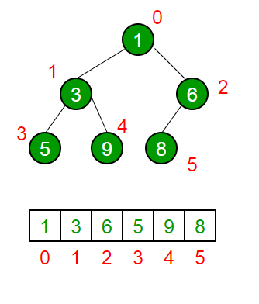
Heap
Heap is complete binary tree
MIN heap: children are bigger than parent
MAX heap: children are smaller than parent
Find / insert / remove time: O(log n)
Used for Heapsort algorithm
Usually stored as array to make operations easier and take less space
Priority queue is implemented with heap
Priority queue is queue which is sorted by priority of tasks (not by FIFO)
more important elements will be served first
In java API generic class: PriorityQueue
Main methods: offer, peek, poll and remove

Slide 7


Slide 8
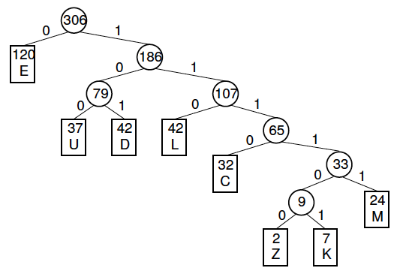
Huffman tree
Used for binary encoding
More frequent elements have shorter codes
public class HuffmanTree implements Comparable<Node> {
public class Node {
int freq;
E symbol;
Node left;
Node right;
public Node(int f, E s, Node<E> l, Node<E> r) {
freq = f;
symbol = s;
left = l;
right = r;
}
}
Node root = null;
public int compareTo (Node x) {
return freq - x.freq;
}
public void createTree(PriorityQueue<Node<E>> p) {
if (p != null)
while (p.size() > 1) {
Node val1 = p.pool();
Node val2 = p.pool();
root = new Node(val1.f + val2.f, null, val1, val2);
p.offer(root);
} //In java it is best to create tree from priorityQueue
} // which elements are sorted ascendingly by freq

Slide 9
